Slide 1
PLACEMENT STATISTICS
By
Tilakraj Singh Rao (1rn17is109)

Slide 2
INTRODUCTION
A file structure is a combination of representations for data in files and of operations for accessing the data.
A file structure allows applications to read , write , and modify data.
The aim of the project is to design such a system which maintains the placement records of the students.
The administrator takes proper precautionary care so that the details of the students are updated according to the company they are placed in.
The main considerations to be taken in Placement Statistics are the details of the student like USN, the department, the company in which the student is placed and the package offered.

Slide 3
FIELD AND RECORD STRUCTURE
A variable length record is one which differs in length from other records of the file.
The project is designed using the concept of variable length records delimited by an endline character.
The records within a file are followed by a delimiting field which differs each record from one another.
Record 1 \n Record 2 \n Record 3 \n Record 4 \n
The fields within record are also followed by a delimiting byte since each field within record can have different sizes.
FIELD 1 FIELD 2 FIELD 3 FIELD 4

Slide 4
Fields used in this project are:
usn[15]: the usn field of size 15 holds the usn number of the student which is a unique value that identifies each student.
name[20]: the name field of size 20, a variable length type char that is used to store the name of the student.
cname[10]: the cname field of size 10,hold the company name to which the student has got placed.
package[15]: the package field of size 15, store the annual package the company is offering.
dob[10]: the dob field of size 10,hold the information about the age of the student.

Slide 5
B+ TREE
B+ Tree is an extension of B Tree which allows efficient insertion, deletion and search operations.
In B+ tree, records (data) can only be stored on the leaf nodes while internal nodes can only store the key values.
B+ Tree are used to store the large amount of data which can not be stored in the main memory.
Faster search queries as the data is stored only on the leaf nodes.

Slide 6
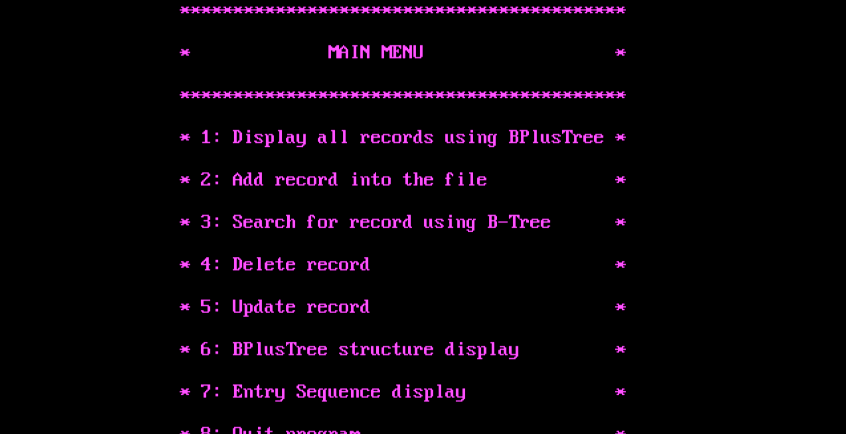
SNAPSHOTS

Slide 7
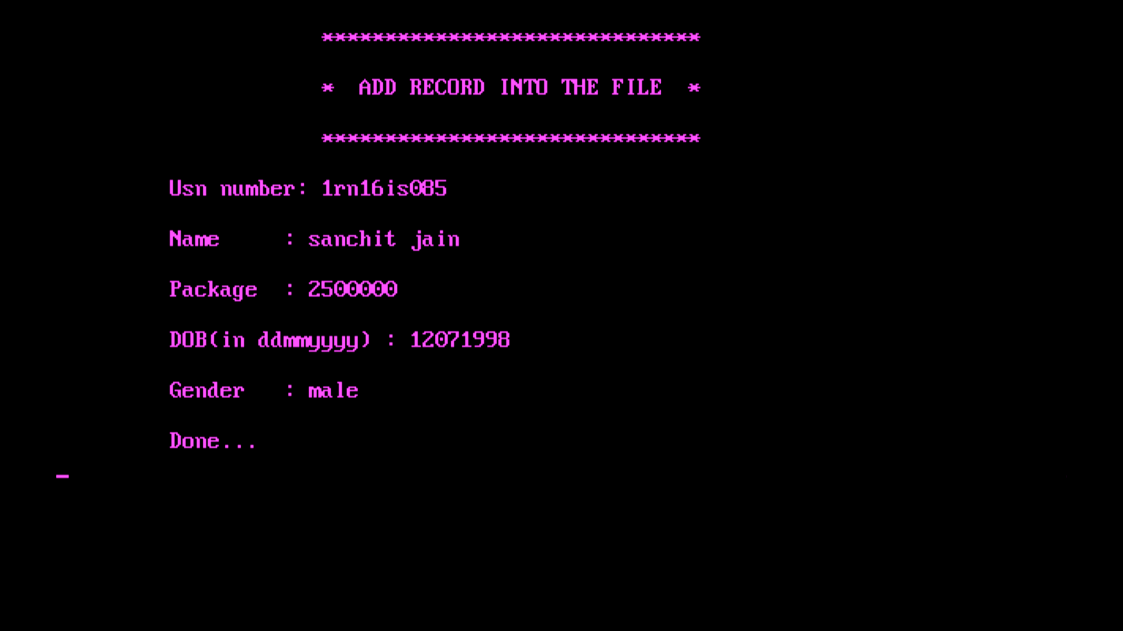
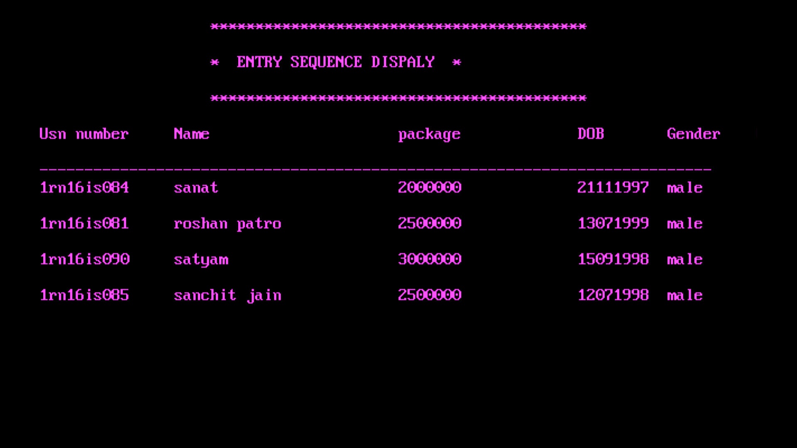

Slide 8
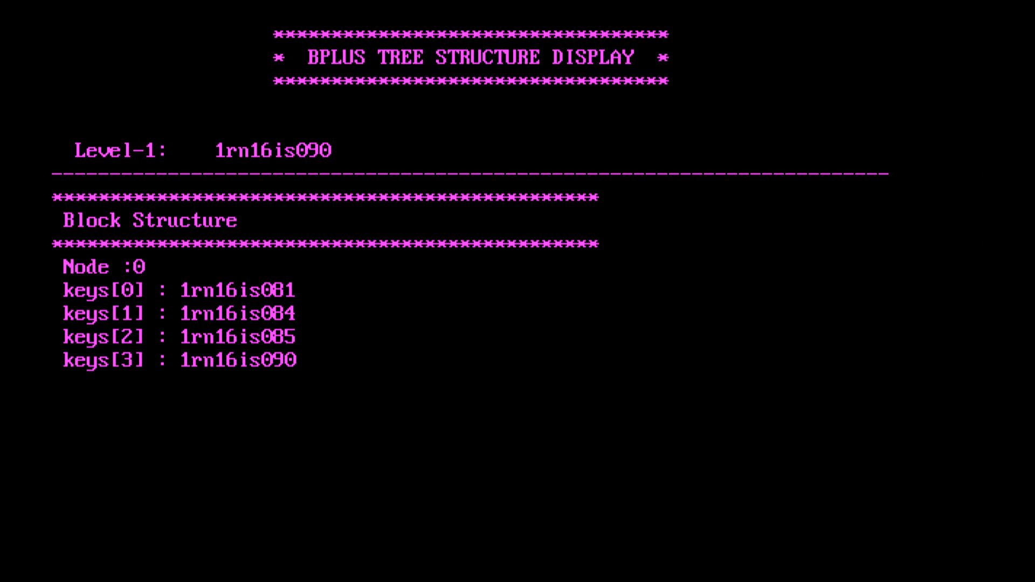

Slide 9
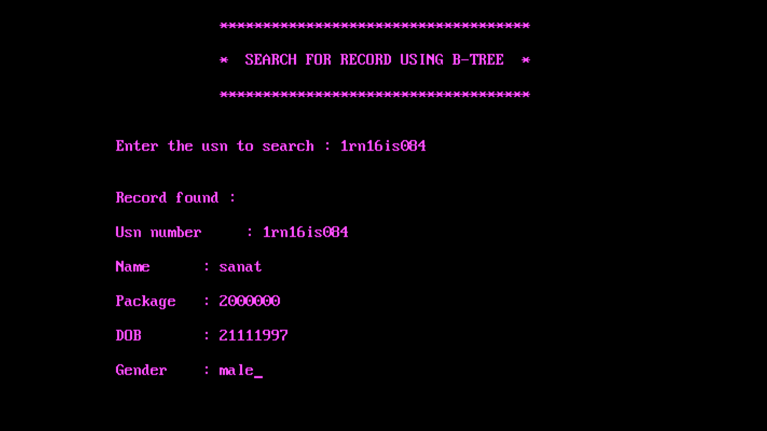
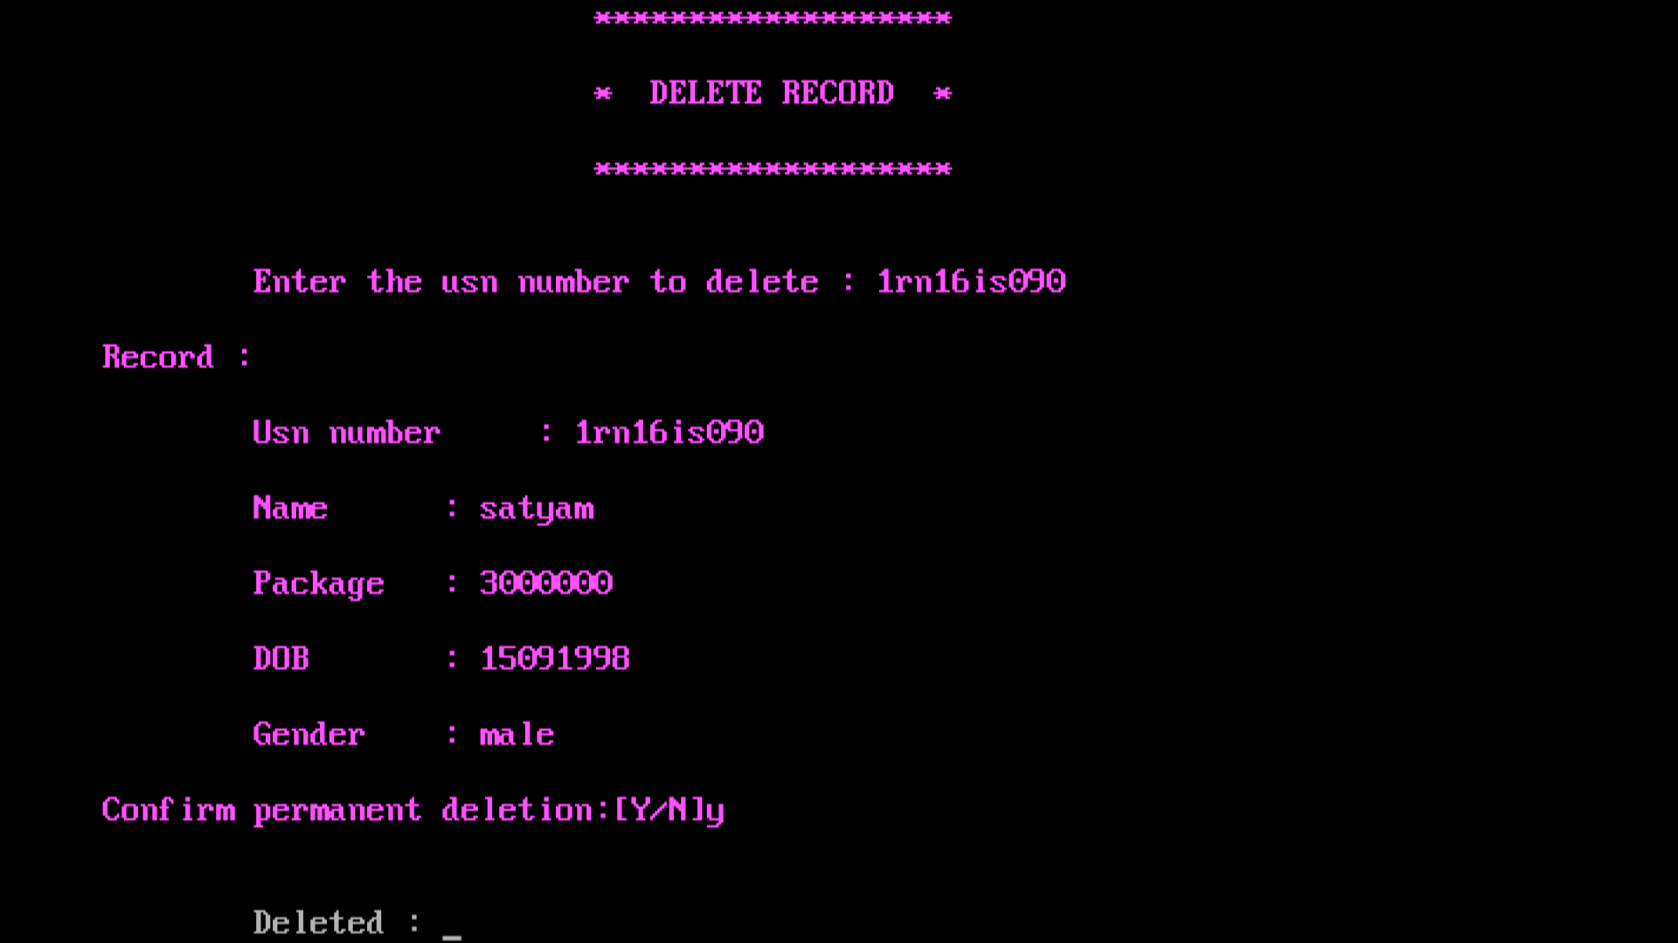

Slide 10
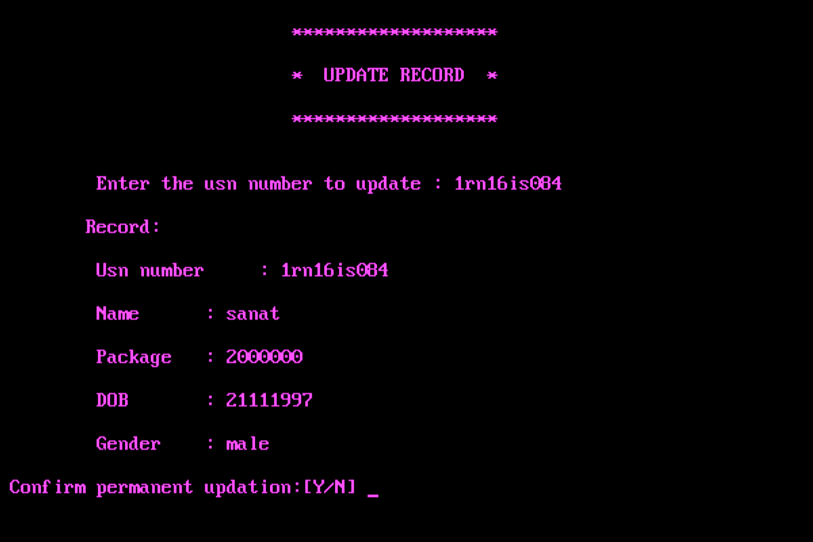

Slide 11
APPLICATIONS
This project can be implemented by colleges to maintain records of students who have been placed.
It is useful in terms of reducing the manual effort which is put into maintaining years of sensitive data. The computerized method of handling records makes the whole process very easy.
The computerized method makes it very convenient to add new records, delete records, search records and modify records while maintaining the integrity and safety of student details.
With further enhancement the application can be hosted to the web.

Slide 12
CONCLUSION
It is a software which helps the user to work with the different branches easily.
This software reduces the amount of manual data entry and gives greater efficiency. The user interface of it is very friendly and can be easily used by anyone.
It also decreases the amount of time taken to write customers details and other modules.
At the end, we can say that this software is performing all the tasks accurately and is doing the work for which it is made.

Slide 13
THANK YOU

